Slide 1
Big Data Analytics course CSDA1000SUMA18 Group 1, Final Project
Airport Gate Assignment Optimization Presentation
Viviane Adohouannon
Kate Alexander
Juan Arangote
Dian Azbel
Igor Baranov
York University School of Continuous Studies

Slide 2
Introduction, Business goal - Juan

Slide 3
Data overview, insight's - Viviane

Slide 4
Airlines performance analysis – Diana & Kate
Topic: The impacts of airline delays on gate management
Where did we get the data from

Slide 5
Question 1 from WhatsApp covo
Baseline:
How many flights we have in total
How many delays we have in total
How many cancellations we have in total
What is the percentage of delays by Airline
What is the percentage of cancellations by Airline

Slide 6
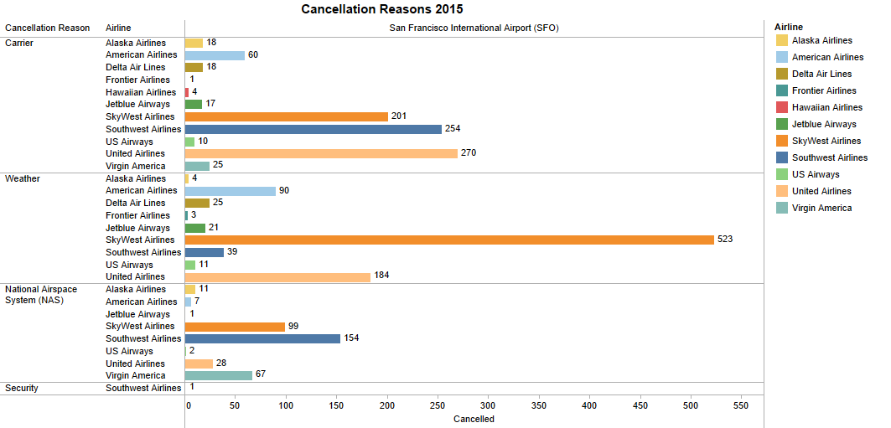
Total of Airline Cancellation based on reason:
Sum of Cancelled for each Airline broken down by Airport Origin vs. Cancellation Reason.
Colour shows details about the Airline.
This view is filtered on Cancellation Reason.

Slide 7
Total of Airline delay based on reason - 2015:

Slide 8
Average delay by airline - 2015:

Slide 9
Cancellation by Airlines only
Graph showing cancellation by reason airline only
Percentage of cancellation caused for each airline – (diana’s python)

Slide 10
Delays that are over 15 min
Percentage of delay by Airlines only

Slide 11
The estimated number of passengers aﬀected by
delays – average
cancellations - average

Slide 12
the estimated ﬁnancial costs, of delays and cancellation

Slide 13
Results:
Performance of the Airlines:
Best airline

Slide 14
Historical data and linear progressing, the estimated future delays and cancellations in the next 5, 10, 20 years by airline
For the best airline only

Slide 15
Competitive analysis - Igor

Slide 16
Model - Igor

Slide 17
Conclusion - Igor

